Slide 1
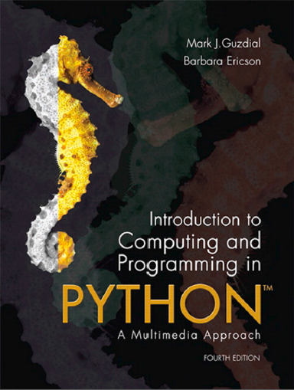
Introduction to Computing and Programming in Python™: A Multimedia Approach
Fourth Edition
Chapter 17
Object-Oriented Programming
Copyright © 2016, 2013, 2010 Pearson Education, Inc. All Rights Reserved
Notes:
If this PowerPoint presentation contains mathematical equations, you may need to check that your computer has the following installed:
1) MathType Plugin
2) Math Player (free versions available)
3) NVDA Reader (free versions available)
Thanks to John Sanders of Suffolk University for contributions to these slides!

Slide 2
Learning Objectives
17.1 To use turtles for graphics—in particular, to create complex recursive patterns.
17.2 To use object-oriented programming to make programming easier to do in teams
17.3 To use object-oriented programming to make programs easier to debug and even more robust.
17.4 To understand such features of object-oriented programs as polymorphism, encapsulation, inheritance, and aggregation.
17.5 To be able to choose between different styles of programming for different purposes.

Slide 3
History of Objects: Where They Came from
Start of the Story: Late 60’s and Early 70’s
Windows are made of glass, mice are undesirable rodents
Good programming = Procedural Abstraction
Verb-oriented

Slide 4
Procedural Abstractions
Define tasks to be performed
Break tasks into smaller and smaller pieces
Until you reach an implementable size
Define the data to be manipulated
Design how functions interact
What’s the input
What’s the output
Group functions into components (“modules” or “classes”)
Write the code

Slide 5
Object-Oriented Programming
First goal: Model the objects of the world
Noun-oriented
Focus on the domain of the program
Phases
Object-oriented analysis: Understand the domain
Define an object-based model of it
Object-oriented design: Define an implementation
Design the solution
Object-oriented programming: Build it

Slide 6
How’d We Get from There to Here?
Key ideas
Master-drawings in Sketchpad
Simulation “objects” in Simula
Alan Kay and a desire to make software better
More robust, more maintainable, more scalable

Slide 7
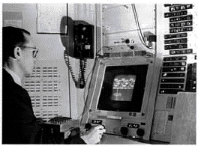
Birth of Objects, (1 of 2)
Ivan Sutherland’s Sketchpad, 1963

Slide 8
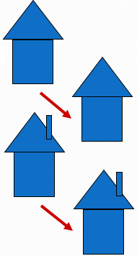
Sketchpad
First object-oriented drawing program
Master and instance drawings
Draw a house
Make an instance
Add a chimney to the master
Poof! The instance grows a chimney
Other interesting features
Mile Square Canvas
Invention of “rubber band” lines
Simple animations

Slide 9
Birth of Objects, (2 of 2)
Simula
Simulation programming language from Norway, 1966
Define an activity which can be instantiated as processes
Each process has it own data and behavior
In real world, objects don't mess with each others’ internals directly
(Simulated) Multi-processing
No Universal Scheduler in the Real World

Slide 10
Alan Kay
U. Utah PhD student in 1966
Read Sketchpad, Ported Simula
Saw “objects” as the future of computer science
His dissertation: Flex, an object-oriented personal computer
A personal computer was a radical idea then

Slide 11
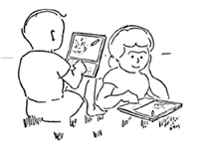
“A Personal Computer for Children of All Ages”
Flex, an object-oriented personal computer
Enabled by Moore’s Law
Imagining personal computing in 1969
Computer as meta-medium
The first medium to encompass other media
A 1970’s depiction of students using an object-oriented system based on Flex

Slide 12
Kay’s Insights
“Computer” as collection of Networked Computers
All software is simulating the real world
Biology as model for objects
Bacterium has 120M of info,
of a Cell, and we have 1013 of these in us.
Talk about processing power! Talk about managing complexity!
What man-made things can scale like that?
Stick a million dog houses together to get the Empire State Building?

Slide 13
Birth of Objects
Objects as models of real world entities
Objects as Cells
Independent, indivisible, interacting—in standard ways
Scales well
Complexity: Distributed responsibility
Robustness: Independent
Supporting growth: Same mechanism everywhere
Reuse: Provide services, just like in real world

Slide 14
Alan Kay’s Dynabook (1972)
Alan Kay sees the Computer as Man’s first metamedium
A medium that can represent any other media: Animation, graphics, sound, photography, etc.
Programming is yet another medium
The Dynabook is a (yet mythical) computer for creative metamedia exploration and reading
Handheld, wireless network connection
Writing (typing), drawing and painting, sound recording, music composition and synthesis
End-user programming

Slide 15
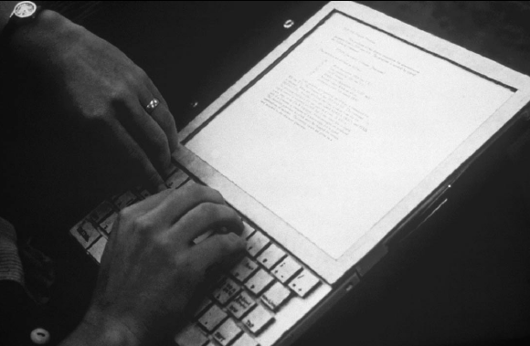
Prototype Dynabook (Xerox P A R C Learning Research Group)

Slide 16
A Dynabook is for Learning
The Dynabook offers a new way to learn new kinds of things
Dynamic systems (like evolution)
Especially decentralized ones (Resnick, 1992)
Knowledge representation (Papert, 1980)
Programming (Kay & Goldberg, 1977)
But need a system for creative expression
In a time when “windows” were made of glass, and “mice” were undesirable rodents

Slide 17
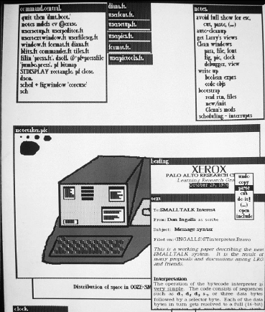
Smalltalk-72
Smalltalk was the programming language invented for the Dynabook.
For the Dynabook, W I M P was invented:
overlapping Windows
Icons
Menus
mouse Pointer

Slide 18
Challenge (1 of 4)
If you interacted with a computer through a terminal (as opposed to punched cards) before Smalltalk-72, what do you think you did to get the computer to do something for you?

Slide 19
A First Object: Logo Turtle
Dr. Seymour Papert at M I T invented the Turtle as a graphical and mathematical object to think with for the children’s programming language, Logo
A turtle is an object.
Every turtle understands the same methods.
Every turtle has the same fields or instance variables.
Heading, body color, pen color, X and Y position.
Yet each turtle can have its own values for these fields.

Slide 20
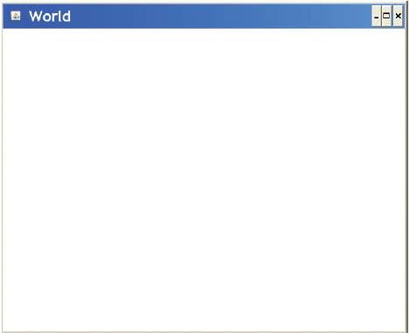
Using Turtles in Python

Slide 21
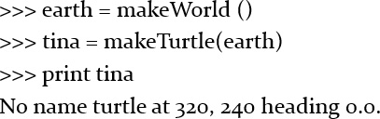
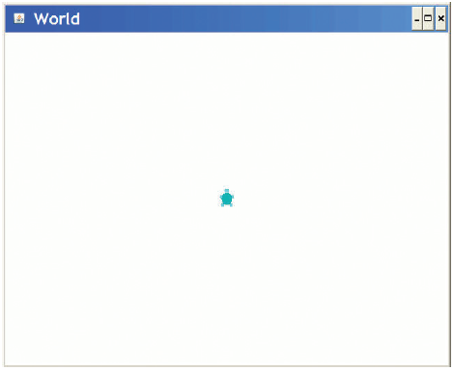
Adding a Turtle to Our World

Slide 22
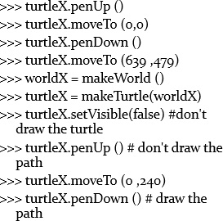
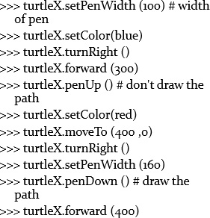
Things Turtles Can Do: Try It!

Slide 23
Talking to Turtles as Functions or Messages/Methods
We can tell a turtle to go forward by calling a function (telling the function to act on the turtle):
Or we can ask Tina to go forward, a certain amount. We are sending a message to Tina, asking her to execute a function that only turtles know: A “method”

Slide 24
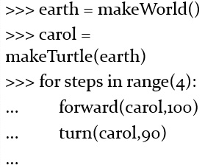
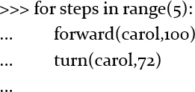
Challenge: What Do These Draw?

Slide 25
Challenge (2 of 4)
How would you draw a triangle?

Slide 26
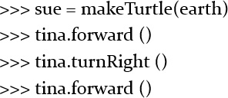
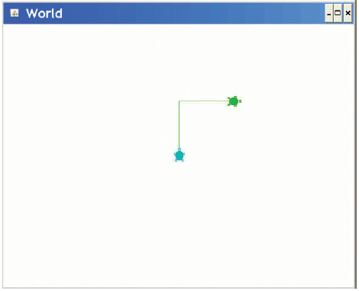
Sending Multiple Turtles Messages
Sue stays put while Tina moves.
These are objects on which we execute methods.

Slide 27
Each Turtle Knows the Same Things, Has the Same State
Each turtle knows how to go forward and turn.
Each knows a heading and an X and Y position.
But each turtle has its own X and Y and heading values.

Slide 28
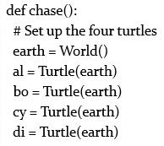
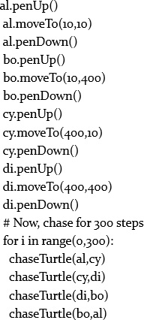
Using Multiple Turtles at Once

Slide 29
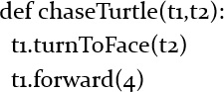
Chasing

Slide 30
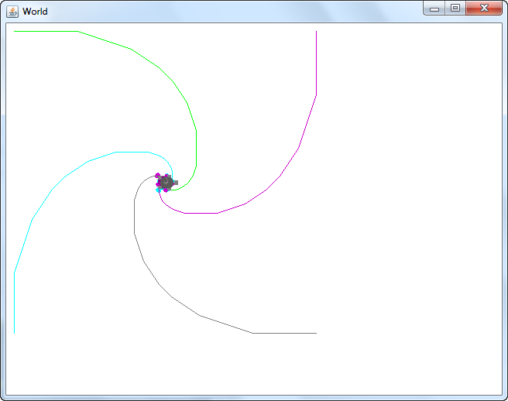
What Four Turtles Chasing Each Other Looks Like

Slide 31
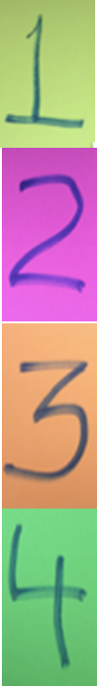
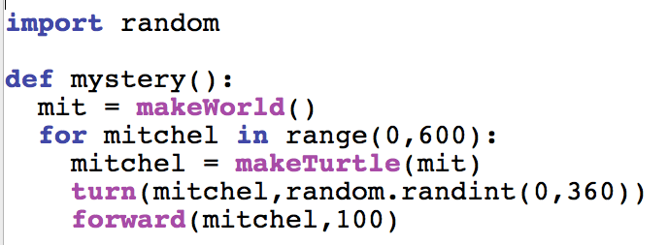
What Shape Does This Draw?
A square with sides of 200
A set of spikes
A circle
Error – you can’t have 600 turtles.
Notes:
#3

Slide 32
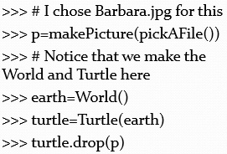
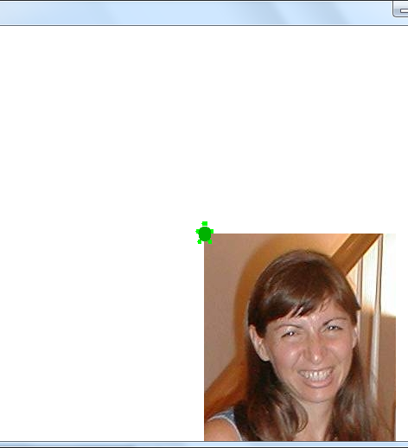
Dropping Pictures from Turtles

Slide 33
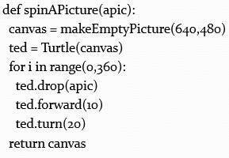
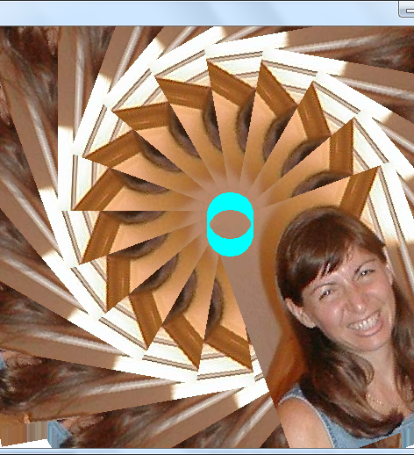
Spinning and Dropping a Turtle on a Canvas

Slide 34
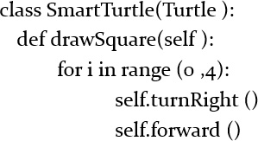
Teaching Turtles New Tricks
The class Turtle exists.
Here, we create a new kind of Turtle, a specialization called SmartTurtle, that knows how to draw squares.
drawSquare is a method that SmartTurtle instances understand.
All Python methods must accept self as the first parameter—self is the object receiving the message.

Slide 35
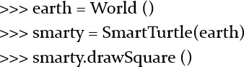
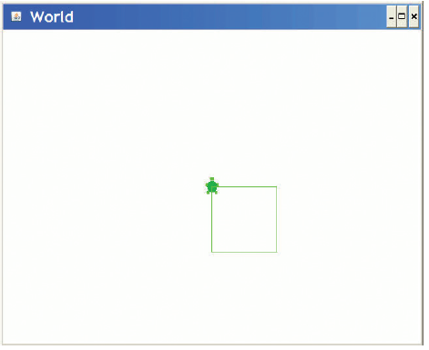
Trying Our New Method

Slide 36
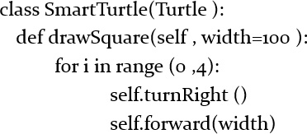
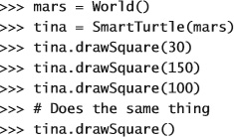
More Than One Method
Now SmartTurtle instances understand both how to drawSquare() and drawSquare(someWidth)

Slide 37
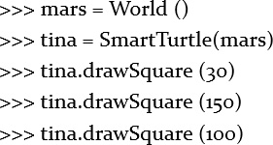
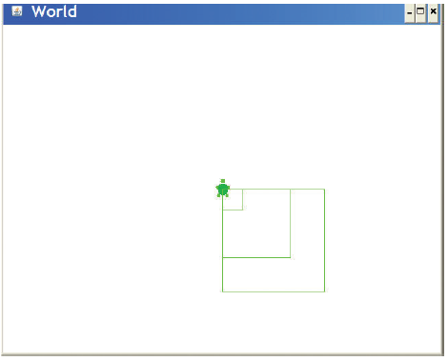
Trying the New Methods

Slide 38
Challenge (3 of 4)
Write the method drawPolygon which takes a size and number of sides.

Slide 39
Inheritance and Overriding
We can create a version of Turtle that’s “confused.”
Turns a random amount.
Goes forward a random amount.
This class is a subclass of Turtle.
That means it inherits everything from Turtle.
It will override how to turn and go forward.

Slide 40
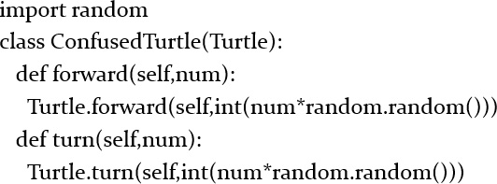
Confusedturtle

Slide 41
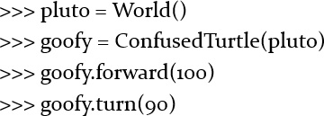
Works the Same, Performs Different

Slide 42
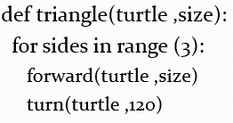
Combining Recursion with Turtles
Start from this:

Slide 43
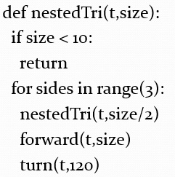
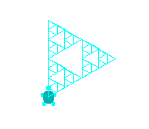
Recurse Before Moving

Slide 44
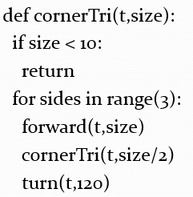
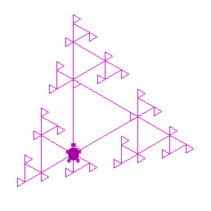
Recurse in the Corners

Slide 45
Example on Making a Class from Scratch: Slideshow
Let’s build a program to show a slide show.
It shows a picture.
Then plays a corresponding sound.
We’ll use the introduced-but-never-used blockingPlay() to make the execution wait until the sound is done.

Slide 46
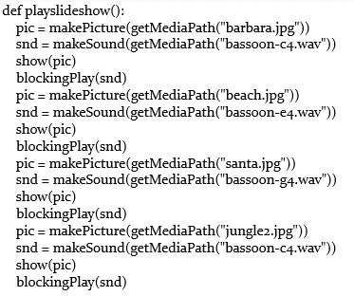
Slideshow

Slide 47
What’s Wrong with This?
From Procedural Abstraction:
We have duplicated code.
We should get rid of it.
From Object-Oriented Programming:
We have an object: A slide.

Slide 48
Defining an Object
Objects know things.
Data that is internal to the object.
We often call those instance variables.
Objects can do things.
Behavior that is internal to the object.
We call functions that are specific to an object methods.
But you knew that one already.
We access both of these using dot notation
object.variable
object.method()

Slide 49
The Slide Object
What does a slide know?
It has a picture.
It has a sound
What can a slide do?
Show itself.
Show its picture.
(Blocking) Play its sound.

Slide 50
Classes
Objects are instances of classes in many object-oriented languages.
Including Smalltalk, Java, JavaScript, and Python.
A class defines the data and behavior of an object.
A class defines what all instances of that class know and can do.

Slide 51
We Need to Define a Slide Class
Easy enough:
class slide:
That wasn’t so hard was it?
What comes next?
Some method for creating new slides.
Some method for playing slides.

Slide 52
Creating New Instances
We are going to create new instances by calling the class name as if it were a function.
That will automatically create a new instance of the class.

Slide 53
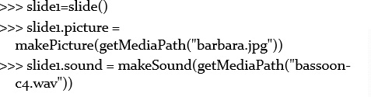
Creating a Slide
Let’s create a slide and give it a picture and sound instance variables.

Slide 54
Defining a show() Method
To show a slide, we want to show() the picture and blockingPlay() the sound.
We define the function as part of the class block.
So this is a def that gets indented.

Slide 55
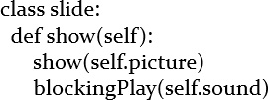
Defining the Method show()
Why self?
When we say object.method(),
Python finds the method in the object’s class, then calls it with the object as an input.
Python style is to call that self.
It’s the object itself.

Slide 56
Now We Can Show Our Slide
We execute the method using the same dot notation we’ve seen previously.
Does just what you’d expect it to do.
Shows the picture.
Plays the sound.

Slide 57
Making It Simpler
Can we get rid of those picture and sound assignments?
What if we could call slide as if it were a real function, with inputs?
Then we could pass in the picture and sound filenames as inputs.
We can do this, by defining what Java calls a constructor.
A method that builds your object for you.

Slide 58
Making Instances More Flexibly
To create new instances with inputs, we must define a function named __init__
That’s underscore-underscore-i-n-i-t-underscore-underscore.
It’s the predefined name for a method that initializes new objects.
Our __init__ function will take three inputs:
self, because all methods take that.
And a picture and sound filename.
We’ll create the pictures and sounds in the method.

Slide 59
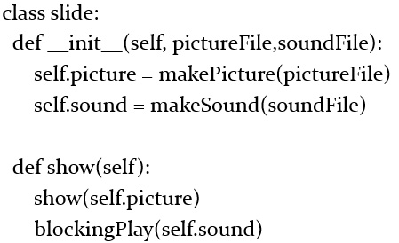
Our Whole Slide Class

Slide 60
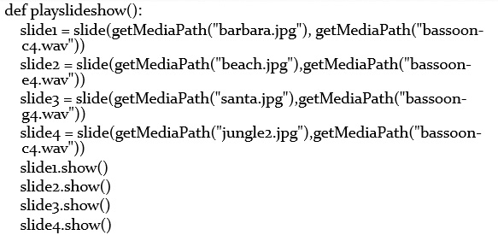
The playslideshow()

Slide 61
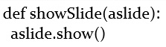
Using Map with Slides
Slides are now just objects, like any other kind of object in Python.
They can be in lists, for example.
Which means that we can use map.
We need a function:

Slide 62
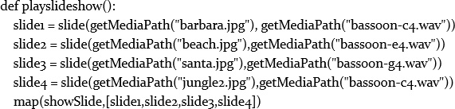
Playslideshow with Map

Slide 63
But Not Very “Object-Oriented”
This version of the slide object is not very object oriented.
We set the picture and sound by directly touching the instance variables.
Adele Goldberg, who helped invent the first programming language Smalltalk, said that a key rule of object-oriented programming is, “Ask, don’t touch.”
How do we let user’s “ask” to access instance variables?
By creating methods for getting (“getters”) and setting (“setters”) instance variables.

Slide 64
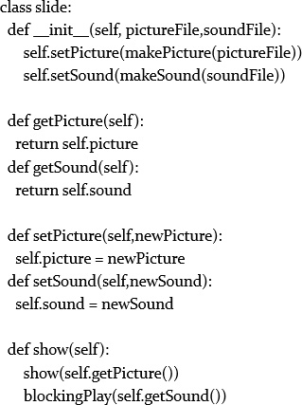
Class with Getters and Setters

Slide 65
Challenge (4 of 4)
Write a version of this function where you also change the sounds and pictures in the objects (using setters and getters), then replay the slide show.

Slide 66
The Value of Objects
Is this program easier to write?
It certainly has less replication of code.
It does combine the data and behavior of slides in one place.
If we want to change how slides work, we change them in the definition of slides.
We call that encapsulation: Combining data and behavior related to that data.
Being able to use other objects with our objects is powerful.
Being able to make lists of objects, to be able to use objects (like picture and sound) in our objects.
We call that aggregation: Combining objects, so that there are objects in other objects.

Slide 67
We’ve Been Doing This Already, of Course
You’ve been using objects already, everywhere.
Pictures, sounds, samples, colors—these are all objects.
We’ve been doing aggregation.
We’ve worked with or talked about lists of pictures, sounds, pixels, and samples
The functions that we’ve been providing merely cover up the underlying objects.

Slide 68
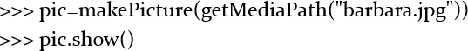
Using Picture as An Object

Slide 69
Slides and Pictures Both show()
Did you notice that we can say slide1.show() and pic.show()?
Show() generally means, in both contexts, “show the object.”
But what’s really happening is different in each context!
Slides show pictures and play sounds.
Pictures just show themselves.

Slide 70
Another Powerful Aspect of Objects: Polymorphism
When the same method name can be applied to more than one object, we call that method polymorphic
From the Greek “many shaped”
A polymorphic method is very powerful for the programmer.
You don’t need to know exactly what method is being executed.
You don’t even need to know exactly what object it is that you’re telling to show()
You just know your goal: Show this object!

Slide 71
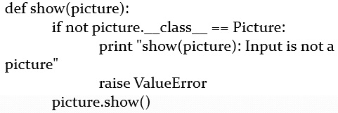
Uncovering the Objects
This is how the show() function is defined in J E S:
You can ignore the raise and if
The key point is that the function is simply executing the method.

Slide 72
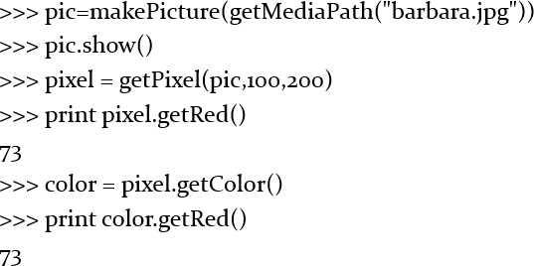
Pictures and Colors Have Polymorphic Methods, Too

Slide 73
We Can Get/Set Components at Either Level
getRed, getBlue, getGreen, setRed, setBlue, setGreen
Are all defined for both colors and pixels
Why didn’t we define the functions to work with either?
It’s somewhat confusing to have a globally-available function take two kinds of things as input: Colors or pixels.
But it’s completely reasonable to have a method of the same name in more than one object.

Slide 74
More Methods Than Functions
In general, there are many more methods defined in J E S than there are functions.
Most specifically, there are a whole bunch of methods for drawing onto a picture that aren’t defined as functions.
We simply ran out of time/energy to convert them all into functions.
And we rationalized that it was easier to deal with the complexity at the level of methods than functions.

Slide 75
Overview of Graphics Methods
pic.addRect(color,x,y,width,height)
pic.addRectFilled(color,x,y,width,height)
pic.addOval(color,x,y,width,height)
pic.addOvalFilled(color,x,y,width,height)

Slide 76
Arcs
pic.addArc(color,x,y,width,height,startangle,arcangle)
pic.addArcFilled(color,x,y,width,height,startangle,arcangle)
Make an arc for arcangle degrees, where startangle is the starting point. 0 = 3 o’clock.
Positive arc is counter-clockwise, negative is clockwise
Center of the circle is middle of the rectangle (x,y) with given height and width

Slide 77
Text
Text can have style, but only limited.
Java limits it for cross-platform compatibility.
pic.addText(color,x,y,string)
pic.addTextWithStyle(color,x,y,string,style)
Style is made by makeStyle(font,emph,size)
Font is sansSerif, serf, or mono
Emph is italic, bold, or plain.
You can get italic, bold by italic+bold
Size is a point size

Slide 78


Rectangles: Coloring Lines and Fills
writeTo() is polymorphic for both sounds and pictures.

Slide 79


Ovals

Slide 80


Arcs and Colored Lines

Slide 81


Text Examples

Slide 82


Sunset Using Methods
Any of our older functions will work just fine with methods.

Slide 83

Backwards Using Methods
To get the sample object, snd.getSampleObjectAt(index)

Slide 84
Subclass Picture and Sound
If we want to make our own methods on Picture and Sound, we have to subclass them.
The new subclass will know everything from the Parent class.
But we can teach it new methods.

Slide 85


Making Sunset a Method

Slide 86


Making Reverse a Method

Slide 87
Why Objects?
An important role for objects is to reduce the number of names that you have to remember.
writeSoundTo() and writePictureTo() vs. sound.writeTo() and picture.writeTo()
They also make it easier to change data and behavior together.
Think about changing the name of an instance variable. What functions do you need to change? Odds are good that they’re the ones right next to where you’re changing the variable.
Most significant power is in aggregation: Combining objects

Slide 88
Python Objects vs. Other Objects
One of the key ideas for objects was “not messing with the innards.”
Not true in Python.
We can always get at instance variables of objects.
It is true in other object-oriented languages.
In Java or Smalltalk, instance variables are only accessible through methods (getPixel) or through special declarations (“This variable is public!”)

Slide 89
Inheritance
We can declare one class to be inherited by another class.
It provides instant polymorphism.
The child class immediately gets all the data and behavior of the parent class.
The child can then add more than the parent class had.
This is called making the child a specialization of the parent.
A 3-D rectangle might know/do all that a rectangle does, plus some more:
class rectangle3D(rectangle):

Slide 90
Inheritance is a Tradeoff
Inheritance is talked about a lot in the object-oriented world.
It does reduce even further duplication of code.
If you have two classes that will have many the same methods, then set up inheritance.
But in actual practice, inheritance doesn’t get used all that much, and can be confusing.

Slide 91
When Should You Use Objects?
Define your own objects when you have:
Data in groups, like both pictures and sounds.
Behavior that you want to define over that group.
Use existing objects:
Always—they’re very powerful!
Unless you’re not comfortable with dot notation and the idea of methods.
Then functions work just fine.

Slide 92

Copyright

